Slide 1


Academic Advisory Committee
University Rectors of Greece
Exploring Partnerships
Washington, D.C.
January 16, 2011

Slide 2


Opportunities for Partnerships:
Global Connections
All universities are aspiring to be more ‘global’;
There are many opportunities to create partnerships with other universities as well as with programs/departments within universities;
While administrative leadership is important, faculty leadership and local champions are essential to the success of any global initiative;
Global programs should intellectually transform and enhance the institutions, programs and all the people involved in them.

Slide 3

Who and What Move Across Borders?
People (Students, Faculty)
Programs (Independently or through Partnerships)
Providers (Physical Presence)
But also electronic flow and Global communication

Slide 4
Viterbi Global Activities (I)
Relationships With Top Universities Overseas
  Viterbi partnerships with IIT (India), Tsihghua (China)
  A number of MOUs with top institutions overseas- people, through visits or exchange programs
  Extensive faculty relationships with overseas institutions- almost half of Viterbi faculty are foreign-born
Sponsored Research from Overseas Sponsors
  Viterbi partnership with KAL- programs/services
  INFOSYS new software center at USC- “reverse off-shoring”

Slide 5
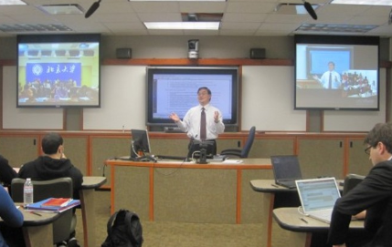
Viterbi Global Activities (II)
Engineering Education Using the Web
  Viterbi’s Distance Education Network- programs/services
  But also the MIT OpenCourseWare model- The Meta-University (Vest, 2008)- Viterbi aspires to do same with PhD courses
  i-Podium- Synchronous course between USC and PKU (Peking University)
PKU
PKU
USC

Slide 6
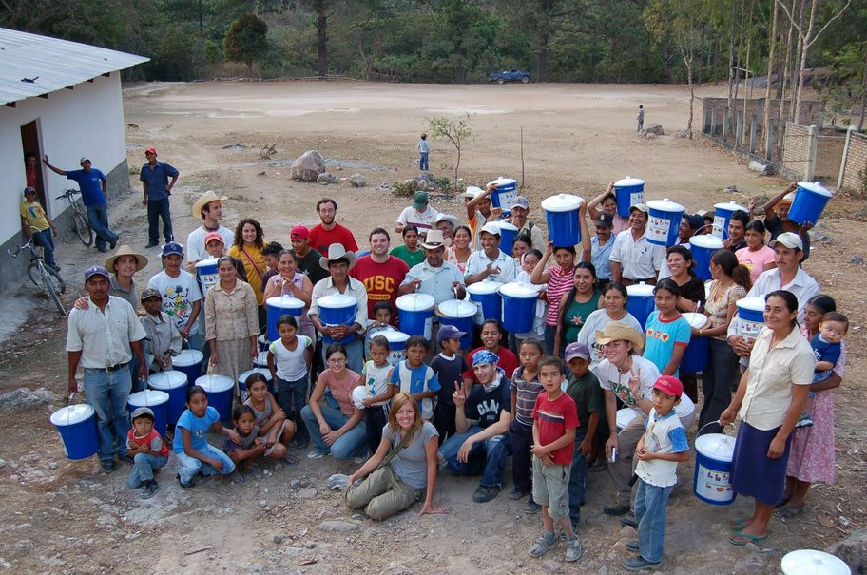
Viterbi Global Activities (III)
Undergraduate Global Outreach
  Engineers without borders (EWB)- service mission
  Summer overseas
EWB- Honduras H₂O:
Water Purification Plant

Slide 7
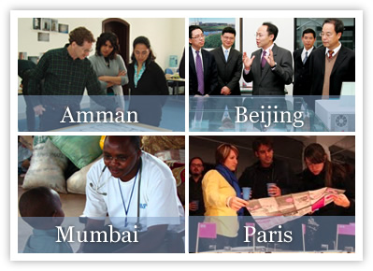
People Moving Across Borders:
Institutional Level
Columbia University
Global Centers:
Supporting teaching and research across two or more world regions…

Slide 8
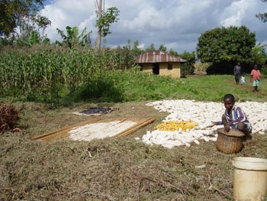
Millenium Villages
Ten African Countries
Community-led development in rural Africa to fight extreme poverty…

Slide 9
Moving Across Borders:
School level
Columbia College (undergraduate)
Study Abroad and Summer Programs
School of Architecture (graduate)
Studio x
School of Social Work (graduate)
Professionalizing Social Work in Jordan
Teachers College (graduate)
Improving Teaching in Jordan

Slide 10
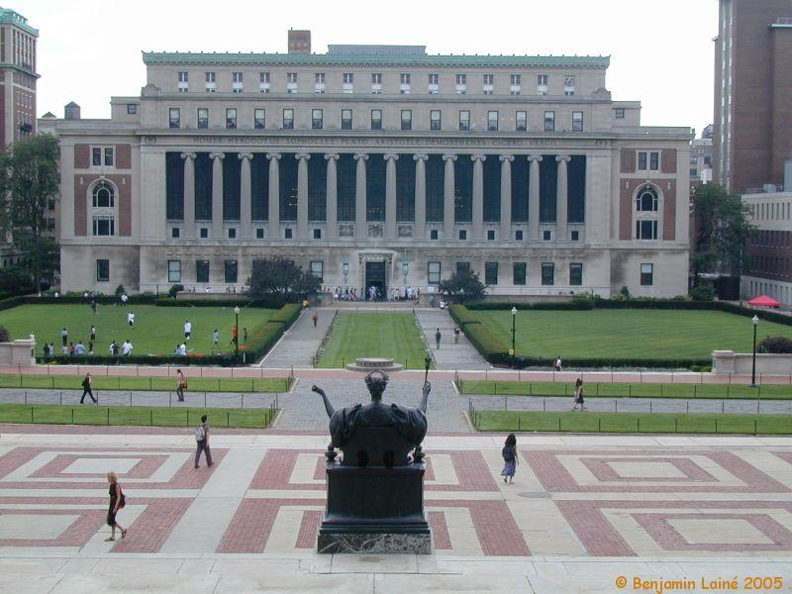
Columbia University
in the
City of New York
Founded in 1754 as King’s College;
A private University with 27,000 students, 4 undergraduate schools and 12 graduate and professional schools;
An endowment of some $6.5 billion represents 13% of the University’s revenue;

Slide 11


Tuition, room, board for Columbia College is $53,876 per year and 50% of the students receive financial aid grants amounting to $80m;
International students make up 23% of the student body;
Columbia is undertaking a number of new global initiatives.

Slide 12
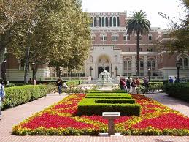
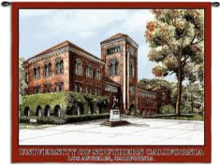

University of
Southern California
in Los Angeles
Founded in 1880;
A private University with 35,000 students (about 6000 international), about 3000 faculty,200,000 alumni and 19 professional schools;
An endowment of approximately $3.6 billion; a $2 billion budget; and more than $500 M annual research expenditures.

Slide 13
Final Thought:
Global programs, correctly designed and administered, intellectually transform and generally improve the institutions, programs and all the people involved in the programs…

